Slide 1
Valid Parentheses Checker
Implemented in Java using Array-Based Stack Lucas Pelaez

Slide 2
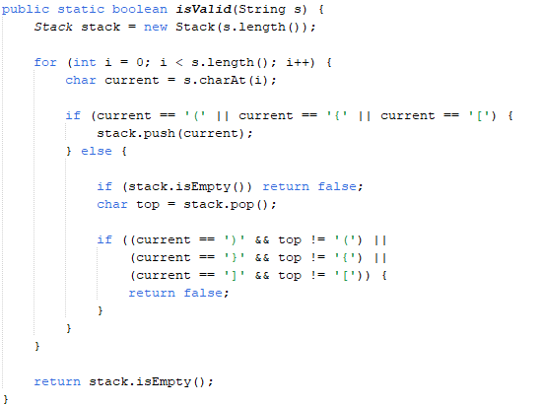
Objective: Check if a string of brackets is valid.
Rules for Validity:
Every open bracket must be closed.
Brackets must close in the correct order.
Types must match: (), {}, []

Slide 3

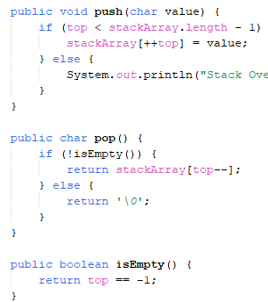

Why a Stack?
Follows Last In, First Out (LIFO) order.
Matches the bracket pairing logic.
Operations Used:
push(char) -> Add an opening bracket
pop() -> Remove last opening bracket
isEmpty() -> Check if all brackets matched

Slide 4
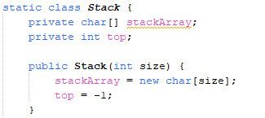
- Manual stack using a char[] array. - Avoids built-in Java Stack class.
- Provides full control and performance. - Handles overflow and underflow safely.

Slide 5
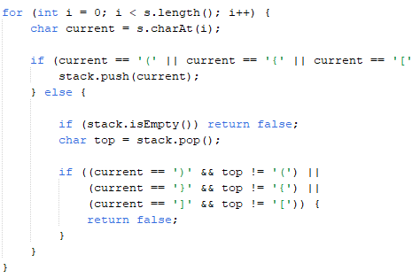
Loop through each character in the string.
If it's an opening bracket, push it.
If it's a closing bracket:
If stack is empty → invalid
If top doesn't match → invalid
Else, pop the top
Final check: Stack must be empty for valid input.

Slide 6
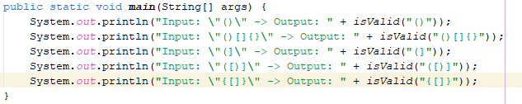
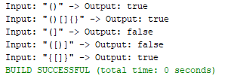
Sample Inputs & Outputs

Slide 7
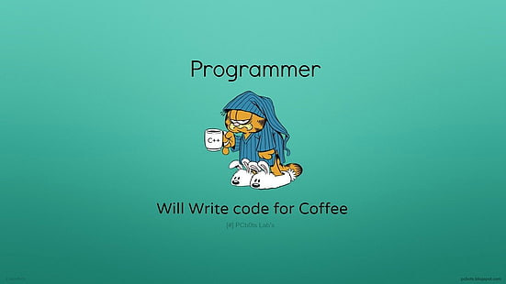
Time Complexity: O(c) -> c = length of the string
Space Complexity: O(c) -> maximum size of the stack
Summary
Efficient bracket validation using a stack
Custom implementation without Java library stack
Demonstrates O(c) performance and algorithm clarity

